Slide 1
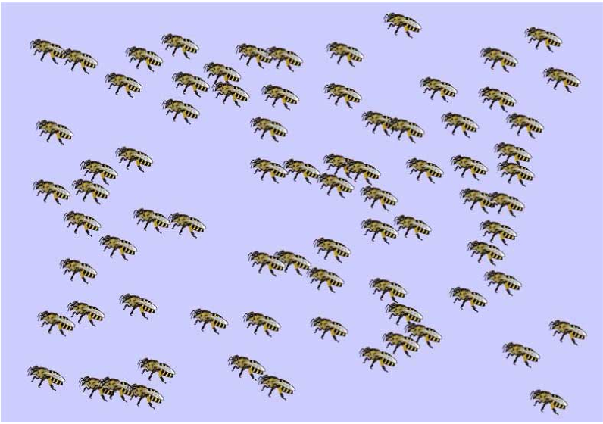













a
Stimulus
First estimate $(E_{1})$
Second estimate $(E_{2})$
You $(E_{1})$
$$(E_{2})$$
Peer $(X)$
Your estimate is:
60
How confident are you?
1
2
3
4
5
6
7
8
9
10
1
2
3
4
5
6
7
8
9
10
Your estimate is:
68
6s
up to 30s
up to 30s
b
Stimulus
First estimate $(E_{1})$
Second estimate $(E_{2})$
You $(E_{1})$
$$(E_{2})$$
DEM
REP
DEM
REP
45
55
40
60
52
48
Confidence:
Low
High
Peer $(X)$
High
up to 30s
up to 30s

